Slide 1

Big Data

Slide 2
Big data is
The collection of datasets of large and complex structures which is difficult to process using on hand database tools or Traditional data processing applications.
The challenges include capture, curation, storage, search, sharing, transfer, analysis and visualization.

Slide 3
Types of data
Quantitative Data
Measurable
Collected through measuring things that have a fixed reality
Close ended
Qualitative Data
Descriptive
Collected through observation, field work, focus groups, interviews, recording or filming conversations
Open ended

Slide 4
V’s of Big data
Volume The amount of data | Variety The types of data
Velocity The frequency of data | Veracity The quality of data

Slide 5
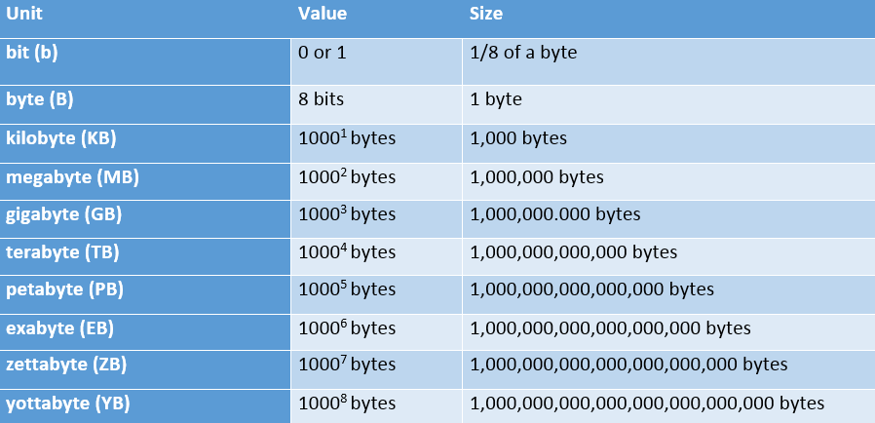
Scale of Data

Slide 6
Definition of V’s Big Data
Volume
Data volume is increasing exponentially
Data Volume 44 times increase from 2009 to 2020
From 0.8 zettabytes to 35zb
Variety
Data Types | Examples
Structured Data | Data from enterprise (ERP, CRM)
Semi Structured Data | xml, json, csv, log files
Unstructured Data / Documents | audio, video, image, archive documents

Slide 7
Velocity
Data is generated fast and need to be processed fast
Online Data Analytics
Late decisions
missing opportunities
Veracity
Origin
Authenticity
Trustworthiness
Completeness
Integrity

Slide 8
Big Data Scenarios
Web and e-tailing
Recommendation Engines
Ad Targeting
Search Quality
Abuse and Click Fraud Detection
Telecommunication
Customer Churn Analysis and Prevention
Network Performance Optimization
Call Data Record (CDR) Analysis
Analysing Network to Predict Failure
Government
Fraud Detection and Cyber Security
Welfare Schemes
Justice

Slide 9
Examples
Yahoo!
More than 100,000 CPUs in ~20,000 computers running Hadoop; biggest cluster: 2000 nodes
(2*4cpu boxes with 4TB disk each); used to support research for Ad Systems and Web Search
AOL
Used for a variety of things ranging from statistics generation to running advanced algorithms for
doing behavioural analysis and targeting; cluster size is 50 machines, Intel Xeon, dual processors,
dual core, each with 16GB Ram and 800 GB hard-disk giving us a total of 37 TB HDFS capacity.
Facebook
To store copies of internal log and dimension data sources and use it as a source for
reporting/analytics and machine learning; 320 machine cluster with 2,560 cores and about 1.3 PB
raw storage;

Slide 10
Why Big Data with Hadoop?
Hadoop was Designed to answer the question “How to process big data with reasonable cost and time”.
Apache’s top level project.
Open source implementation of frameworks for reliable, scalable distributed computing and storage.
It is a flexible and highly-available architecture for large scale computation and data processing on a network of commodity hardware.

Slide 11
What is Hadoop
Open source software platform for scalable, distributed computing
Hadoop provides fast and reliable analysis of both structured data and unstructured data.
Apache Hadoop software library is essentially a framework that allows for the distributed processing of large datasets across clusters of computers using a simple programming model.
Hadoop can scale up from single servers to thousands of machines, each offering local computation and storage.

Slide 12
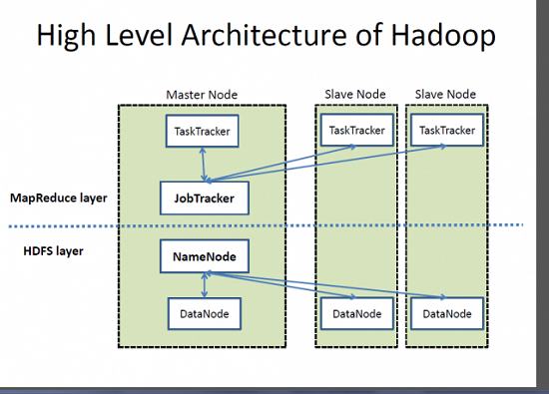

Slide 13
Hadoop Ecosystems Projects
Hadoop Ecosystem Projects includes:
Hadoop Common utilities
HBase: A scalable, distributed database for large tables.
HDFS: A distributed file system.
Hive: data summarization and ad hoc querying.
MapReduce: distributed processing on compute clusters.
Pig: A high-level data-flow language for parallel computation.

Slide 14
Hadoop Distributed File system
A distributed file system that provides high-throughput access to application data
HDFS uses a master/slave architecture in which one device (master) termed as NameNode controls one or more other devices (slaves) termed as DataNode.
It breaks Data/Files into small blocks (128 MB each block) and stores on DataNode and each block replicates on other nodes to accomplish fault tolerance.
NameNode keeps the track of blocks written to the DataNode.

Slide 15
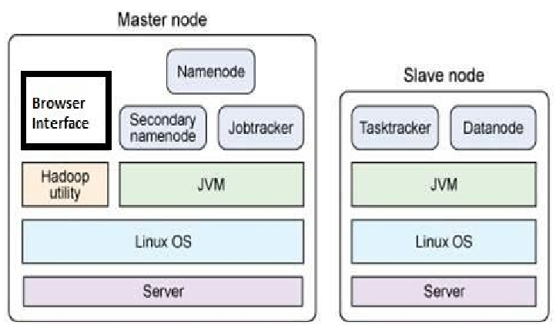
HDFS Cluster Architecture

Slide 16
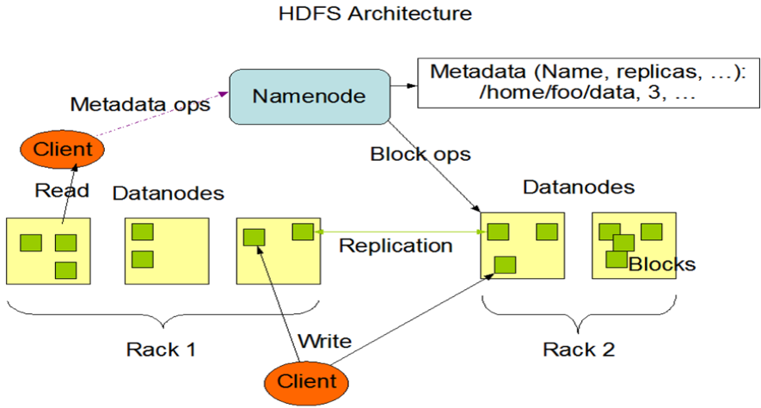
HDFS Architecture

Slide 17
HDFS Daemons
NAME NODE
DATA NODE
SECONDARY NAME NODE

Slide 18
Namenode
Keeps the metadata of all files/blocks in the file system, and tracks where across the cluster the file data is kept.
It does not store the data of these files itself. Kind of block lookup dictionary( index or address book of blocks).
Client applications talk to the NameNode whenever they wish to locate a file, or when they want to add/copy/move/delete a file. The NameNode responds the successful requests by returning a list of relevant DataNode servers where the data lives

Slide 19
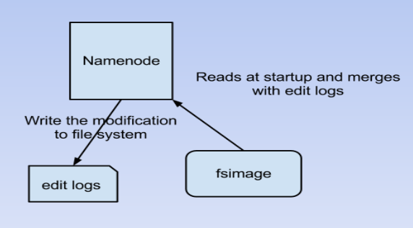
Working Mechanism of Namenode
fsimage - Its the snapshot of the filesystem when NameNode started
Edit logs - Its the sequence of changes made to the filesystem after NameNode started

Slide 20
Datanode
DataNode stores data in the Hadoop Filesystem
A functional filesystem has more than one DataNode, with data replicated across them
On startup, a DataNode connects to the NameNode; spinning until that service comes up. It then responds to requests from the NameNode for filesystem operations.
Client applications can talk directly to a DataNode, once the NameNode has provided the location of the data

Slide 21
Data Replication
Why need data replication ?
HDFS is designed to handle large scale data in distributed environment.
Hardware or software failure, or network partition exist .
Therefore need replications for those fault tolerance

Slide 22
Replication factor Decided by users, and can be dynamically tuned.
How to Create replications efficiently ? Replication pipeline: Instead of single machine create replications, a pipe line is applied .Machine 1 make replication to machine 2, at the same time machine 2 make the replication to machine 3, etc.
Replication placement : High initialization time to create replication to all machines .An approximate solution: Only 3 replications
One replication resides in current node
One replication resides in current rack
One replication resides in another rack

Slide 23
Datanode Failure
Data Node Failure Condition If a data node failed, Name Node could know the blocks it contains, create same replications to other alive nodes, and unregister this dead node
Data Integrity Corruption may occur in network transfer, Hardware failure etc. Apply checksum checking on the contents of files on HDFS, and store the checksum in HDFS namespace If checksum is not correct after fetching, drop it and fetch another replication from other machines.

Slide 24
Secondary Namenode
Not a failover NameNode
The only purpose of the secondary name-node is to perform periodic checkpoints. The secondary name-node periodically downloads current name-node image and edits log files, joins them into new image and uploads the new image back to the (primary and the only) name-node
Default checkpoint time is one hour. It can be set to one minute on highly busy clusters where lots of write operations are being performed.

Slide 25
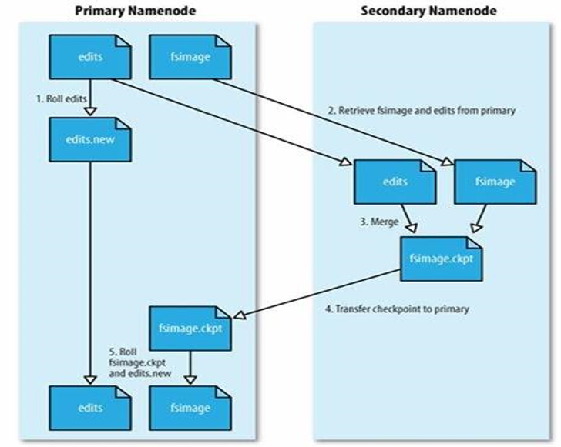

Slide 26
Apache MapReduce
A software framework for distributed processing of large data sets
The framework takes care of scheduling tasks, monitoring them and re-executing any failed tasks.
It splits the input data set into independent chunks that are processed in a completely parallel manner.
MapReduce framework sorts the outputs of the maps, which are then input to the reduce tasks. Typically, both the input and the output of the job are stored in a file system.

Slide 27
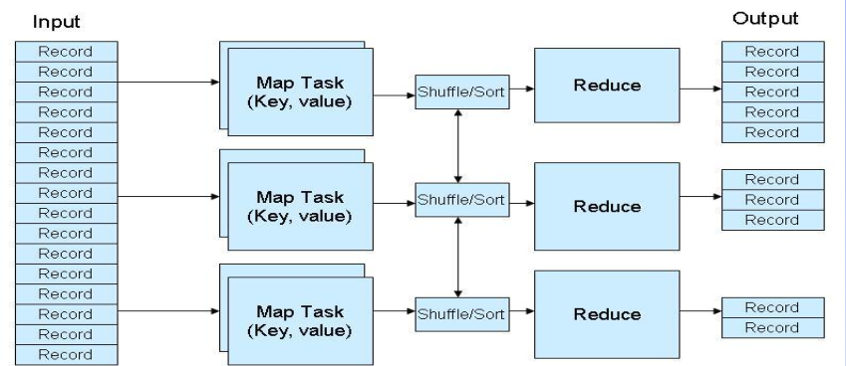
Working of MapReduce

Slide 28
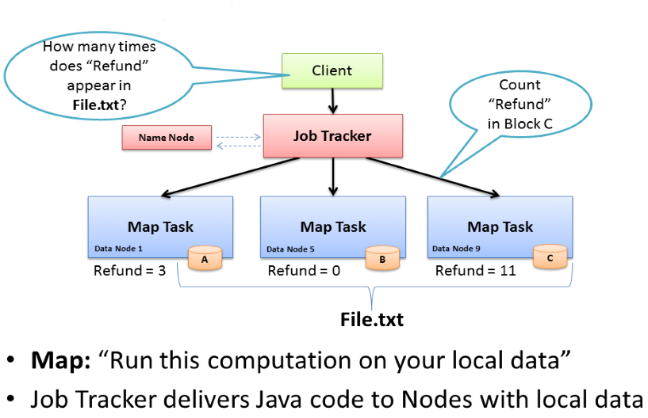
Map Task

Slide 29
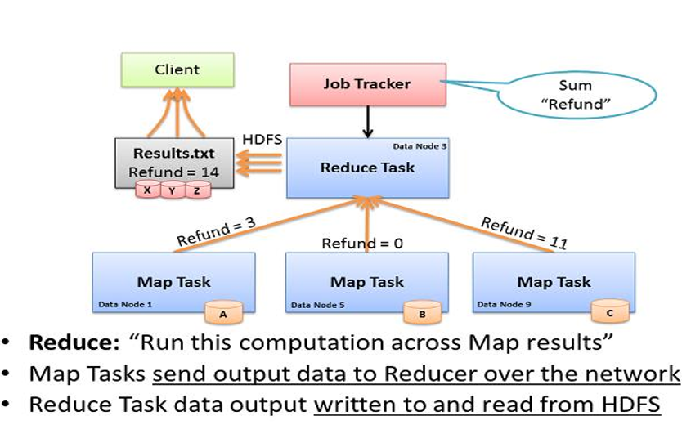
Reduce Task

Slide 30
How data flows in Mapreduce
An input reader
A Map function
A partition function
A compare function
A Reduce function
An output writer
Map Reduce Daemon
JOB TRACKER
TASK TRACKER

Slide 31
Job Tracker
JobTracker is the daemon service for submitting and tracking MapReduce jobs in Hadoop
JobTracker performs following actions in Hadoop :
It accepts the MapReduce Jobs from client applications
Talks to NameNode to determine data location
Locates available TaskTracker Node
Submits the work to the chosen TaskTracker Node

Slide 32
Task Tracker
A TaskTracker node accepts map, reduce or shuffle operations from a JobTracker
Its configured with a set of slots, these indicate the number of tasks that it can accept
JobTracker seeks for the free slot to assign a job
TaskTracker notifies the JobTracker about job success status.
TaskTracker also sends the heartbeat signals to the job tracker to ensure its availability, it also reports the no. of available free slots with it.

Slide 33
Modes of Hadoop cluster
Three supported modes:
Local (Standalone) Mode
Pseudo-Distributed Mode
Fully-Distributed Mode
Standalone Operation
By default, Hadoop is configured to run in a non-distributed mode, as a single Java process.
Pseudo-Distributed Operation
Hadoop can also be run on a single-node in a pseudo-distributed mode where each Hadoop daemon runs in a separate Java process.

Slide 34
Steps
Install JAVA and set PATh
/etc/hosts
.bashrc
ssh-key-gen –t rsa
ssh-copy-id –i …..id_rsa.pub ….
Configure ….Hadoop-env.sh

Slide 35
Pseudo-Distributed Mode ….Cluster Mode
Set Name Node
etc/hadoop/core-site.xml:
<configuration>
<property>
<name>fs.default.name</name>
<value>hdfs://localhost or name of master :9000</value>
</property>
</configuration>
Cluster Multi Node
etc/hadoop/hdfs-site.xml:
<property>
<name>dfs.namenode.dir</name>
value>…/data/nameNode</value>
</property>
<property>
<name>dfs.datanode.dir</name>
value>…/data/dataNode</value>
</property>
</configuration>
SET PATH FOR HDFS
etc/hadoop/hdfs-site.xml:
<configuration>
<property>
<name>dfs.replication</name>
<value>1</value>
</property>

Slide 36
Pseudo-Distributed Mode
Set Yarn as Job Scheduler
etc/hadoop/mapred-site.xml:
<configuration>
<property>
<name>mapreduce.framework.name</name>
<value>yarn</value>
</property>
</configuration>

Slide 37
Configure Yarn
etc/hadoop/yarn-site.xml:
<configuration>
<property>
<name>yarn.acl.enable</name>
<value>0</value>
</property>
<property>
<name>yarn.resourcemanager.hostname</name>
<value>nod-master or name of master</value>
</property>
<property>
<name>yarn.nodemanager.aux-services</name>
<value>mapreduce_shuffle</value>
</property>
</configuration>
Start ResourceManager daemon and NodeManager daemon:
$ sbin/start-yarn.sh

Slide 38
Pseudo-Distributed Mode
Setup passphraseless ssh
ssh-keygen -t rsa -P '' -f ~/.ssh/id_rsa
$ cat ~/.ssh/id_rsa.pub >> ~/.ssh/authorized_keys
$ chmod 0600 ~/.ssh/authorized_keys
The following instructions are to run a MapReduce job locally.
$hdfs namenode –format
$ sbin/start-dfs.sh
Browse the web interface for the NameNode; by default it is available at:
NameNode - http://localhost:9870/

Slide 39
Browse the web interface for the ResourceManager; by default it is available at:
ResourceManager - http://localhost:8088/
$ sbin/stop-yarn.sh

